Slide 1
Name : A.KAVIN
NM.ID : au730321104022
Reg No :730321104022
Dept :B.E-CSE
Year :3rd-year
College : Builders Engineering College

Slide 2
FACE MASK DETECTION
Face mask detection refers to the process of automatically identifying whether individuals in images or videos are wearing face masks. This technology has become particularly relevant during the COVID-19 pandemic as wearing face masks in public places has been widely recommended or mandated by health authorities to help prevent the spread of the virus.

Slide 3


AGENDA
Introduction and Overview
Technologies and Techniques
Implementation and Integration
Challenges and Limitations
Future Directions and Innovations
Conclusion
3/21/2024 Annual Review

Slide 4

PROBLEM STATEMENT
Develop an automated face mask detection system capable of accurately identifying individuals wearing face masks in images or video streams. The system should be deployable in various public settings such as airports, train stations, schools, workplaces, and retail stores to help enforce mask-wearing policies and enhance public safety.
Key Challenges
Variability in Face Masks
Face Occlusions
Complex Backgrounds
Varying Lighting Conditions
Face Orientation and Pose

Slide 5

PROJECT OVERVIEW
The Face Mask Detection System project aimed to develop an automated solution for identifying individuals wearing face masks in images and video streams. The system's primary goal was to aid in enforcing mask-wearing policies in public spaces to mitigate the spread of infectious diseases such as COVID-19.
Objectives:
Develop a robust dataset containing images of individuals with and without face masks.
Implement a deep learning model capable of accurately detecting face masks in images.
Evaluate the model's performance on a separate validation dataset to assess its generalization ability.
Integrate the trained model into a real-time face mask detection application.

Slide 6

WHO ARE THE END USERS?
The end users for face mask detection systems can vary depending on the context and deployment scenario. Here are some potential end users for face mask detection technology:
Healthcare Facilities
Public Transportation Authorities
Educational Institutions
Retail Stores and Businesses
Government Authorities

Slide 7

SOLUTION AND ITS VALUE PROPOSITION
The face mask detection system contributes to public health and safety by ensuring compliance with mask-wearing policies in various settings. By accurately detecting individuals wearing face masks, the system helps mitigate the spread of infectious diseases such as COVID-19 and protects vulnerable populations..
Key components:
Data Collection
Face Detection
Face Alignment
Value Proposition:
Health Protection
Risk Mitigation
Customer and Employee Confidence

Slide 8

THE WOW FACTORS:
Real-time Detection: Instantaneous detection of face masks in live video streams or images, providing immediate feedback on mask-wearing compliance.
High Accuracy: Exceptional accuracy in identifying individuals wearing face masks, even in challenging conditions such as varying lighting, angles, and occlusions.
Robustness: Robust performance across diverse demographics, facial orientations, and mask types, ensuring reliable detection in real-world environments.
Adaptability: Ability to adapt to changing conditions and requirements, including updates to mask-wearing guidelines and regulations.
Scalability: Scalable deployment options that accommodate large crowds and high-traffic areas without compromising performance or reliability.
Customization: Customizable features and configurations to meet the specific needs and preferences of different industries, organizations, and use cases.
Integration: Seamless integration with existing surveillance systems, access control systems, and other infrastructure, enhancing overall security and operational efficiency.
Privacy Protection: Implementation of privacy-preserving techniques and adherence to ethical guidelines to protect users' privacy and data security.
3/21/20

Slide 9
MODELLING
Models:
Single Shot Multi Box Detector (SSD)
Faster R-CNN (Region-based Convolutional Neural Networks)
YOLO (You Only Look Once)
Training the Model:
Initialize the chosen model with pre-trained weights or random weights.
Fine-tune the model on the training set using a suitable optimization algorithm (e.g., Adam, SGD) and loss function (e.g., binary cross-entropy).
Monitor the model's performance on the validation set and adjust hyper parameters (e.g., learning rate, batch size) as needed to prevent over
fitting.

Slide 10
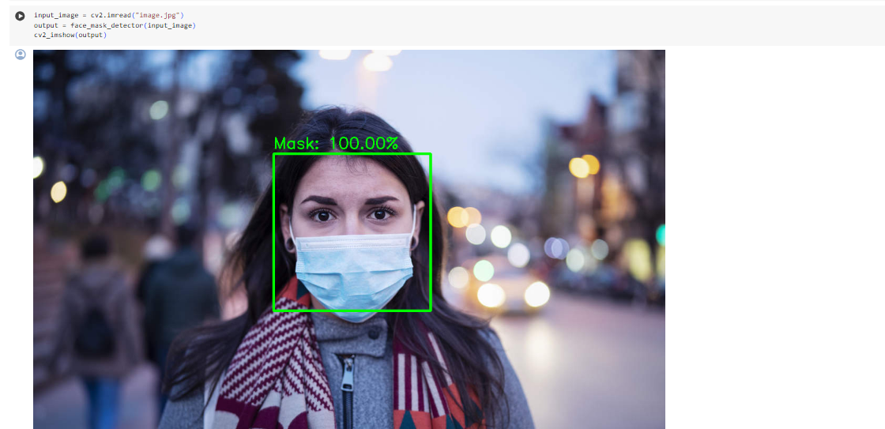
RESULTS

